Slide 1
CIVICS/CIVICS ADV P7 NICOL GONZALEZ ROOM: 220
INTRODUCTIONS Somerset Academy South Homestead

Slide 2


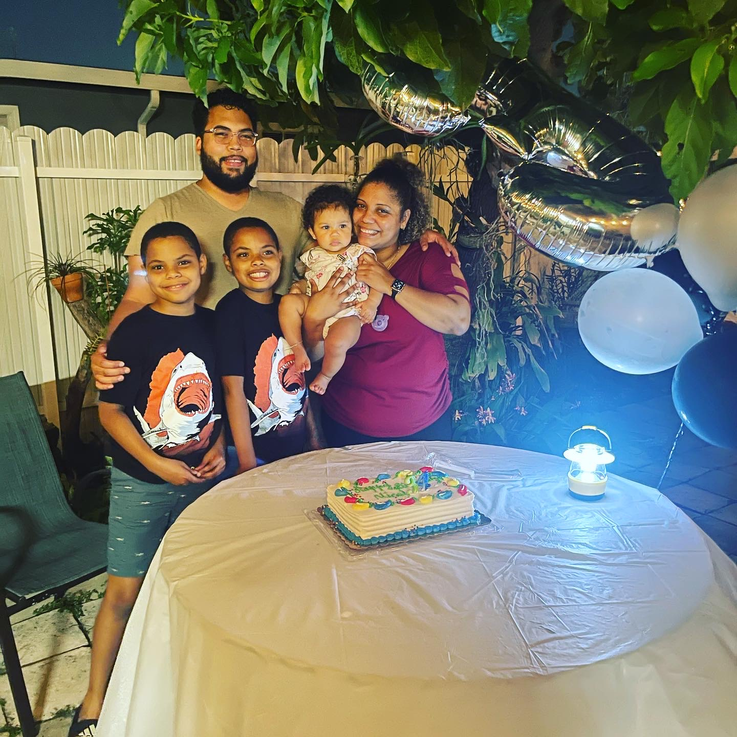

Ms. Nicol Gonzalez
I am your teacher.
Things about me:
I like to bake, watch college football, read a good novel and watch international dramas.
My favorite color is purple.
I am an FSU fan and alumni. Go Seminoles!
I have a fiancé, 3 children, and 1 dog.
My favorite book is ”A World Lit only by Fire” by William Manchester.
Animal: I would be a Ram. They are very independent and direct animals. I am often bull-headed like a ram.

Slide 3

Instructions
Each student will add a slide to the presentation
In your slide you must include:
Your name, class period
A hobby? Something you do outside of school…
Do you have siblings?
A picture of yourself or you and your family
Favorite color
Favorite artist/ favorite sport team/ favorite book
If you could be any animal, what would it be and why?
*** DO NOT CHANGE ORDER OF FIRST #3 SLIDES***
Please add your slide after this slide…
Everyone must have a slide in the PowerPoint for a grade by Friday 8/27/2021.

